Slide 1
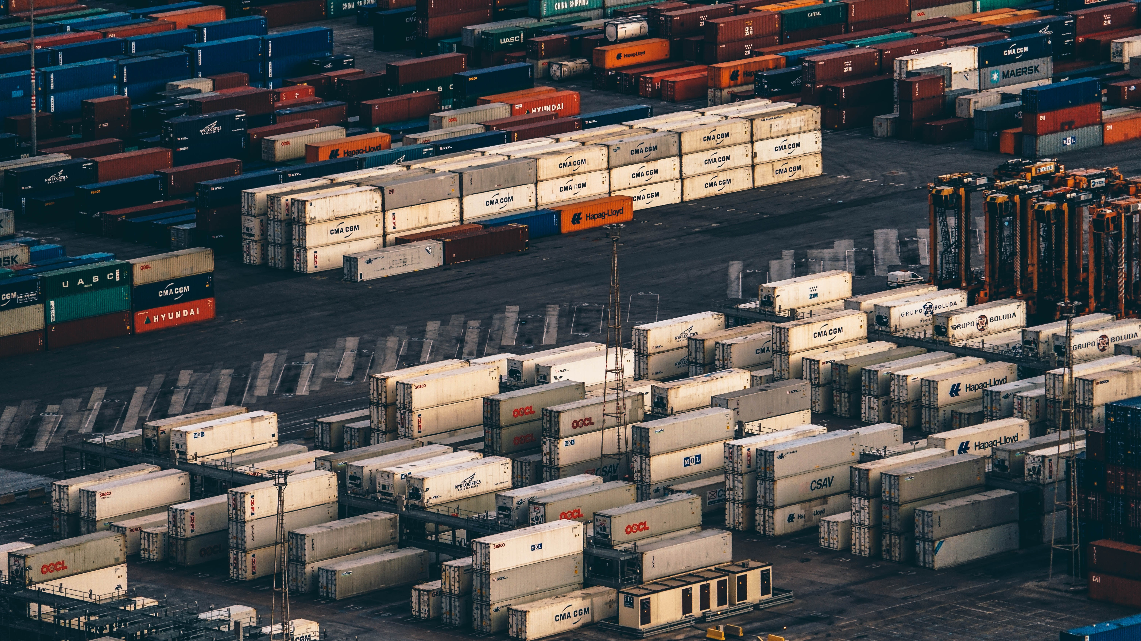
AMIFOST-2018
BLOCKCHAIN
IN FOOD SAFETY AND FOOD TRACEABILITY
Notes:
Food-borne illness is a worldwide problem, and weeks, if not months, can be spent trying to identify, verify and isolate the source of an outbreak. Rising global production and trade has vastly expanded access to food and increased consumer options but this trend has also made food system very complicated. We need a solution for this
My name is Yogesh Tak and I’ll be talking about a breakthrough technology which has the potential for solving challenges in food traceability and food safety. This technology is known as BLOCKCHAIN TECH.

Slide 2

AMIFOST-2018
Blockchain [Cryptocurrency] is the
first thing like the Internet since the Internet.
Notes:
This is crucial thing. Great leaders have said that it is great chain of technology for being sure about things. A new way to making and preserving truths. But when we have internet, why we need blockchains.

Slide 3
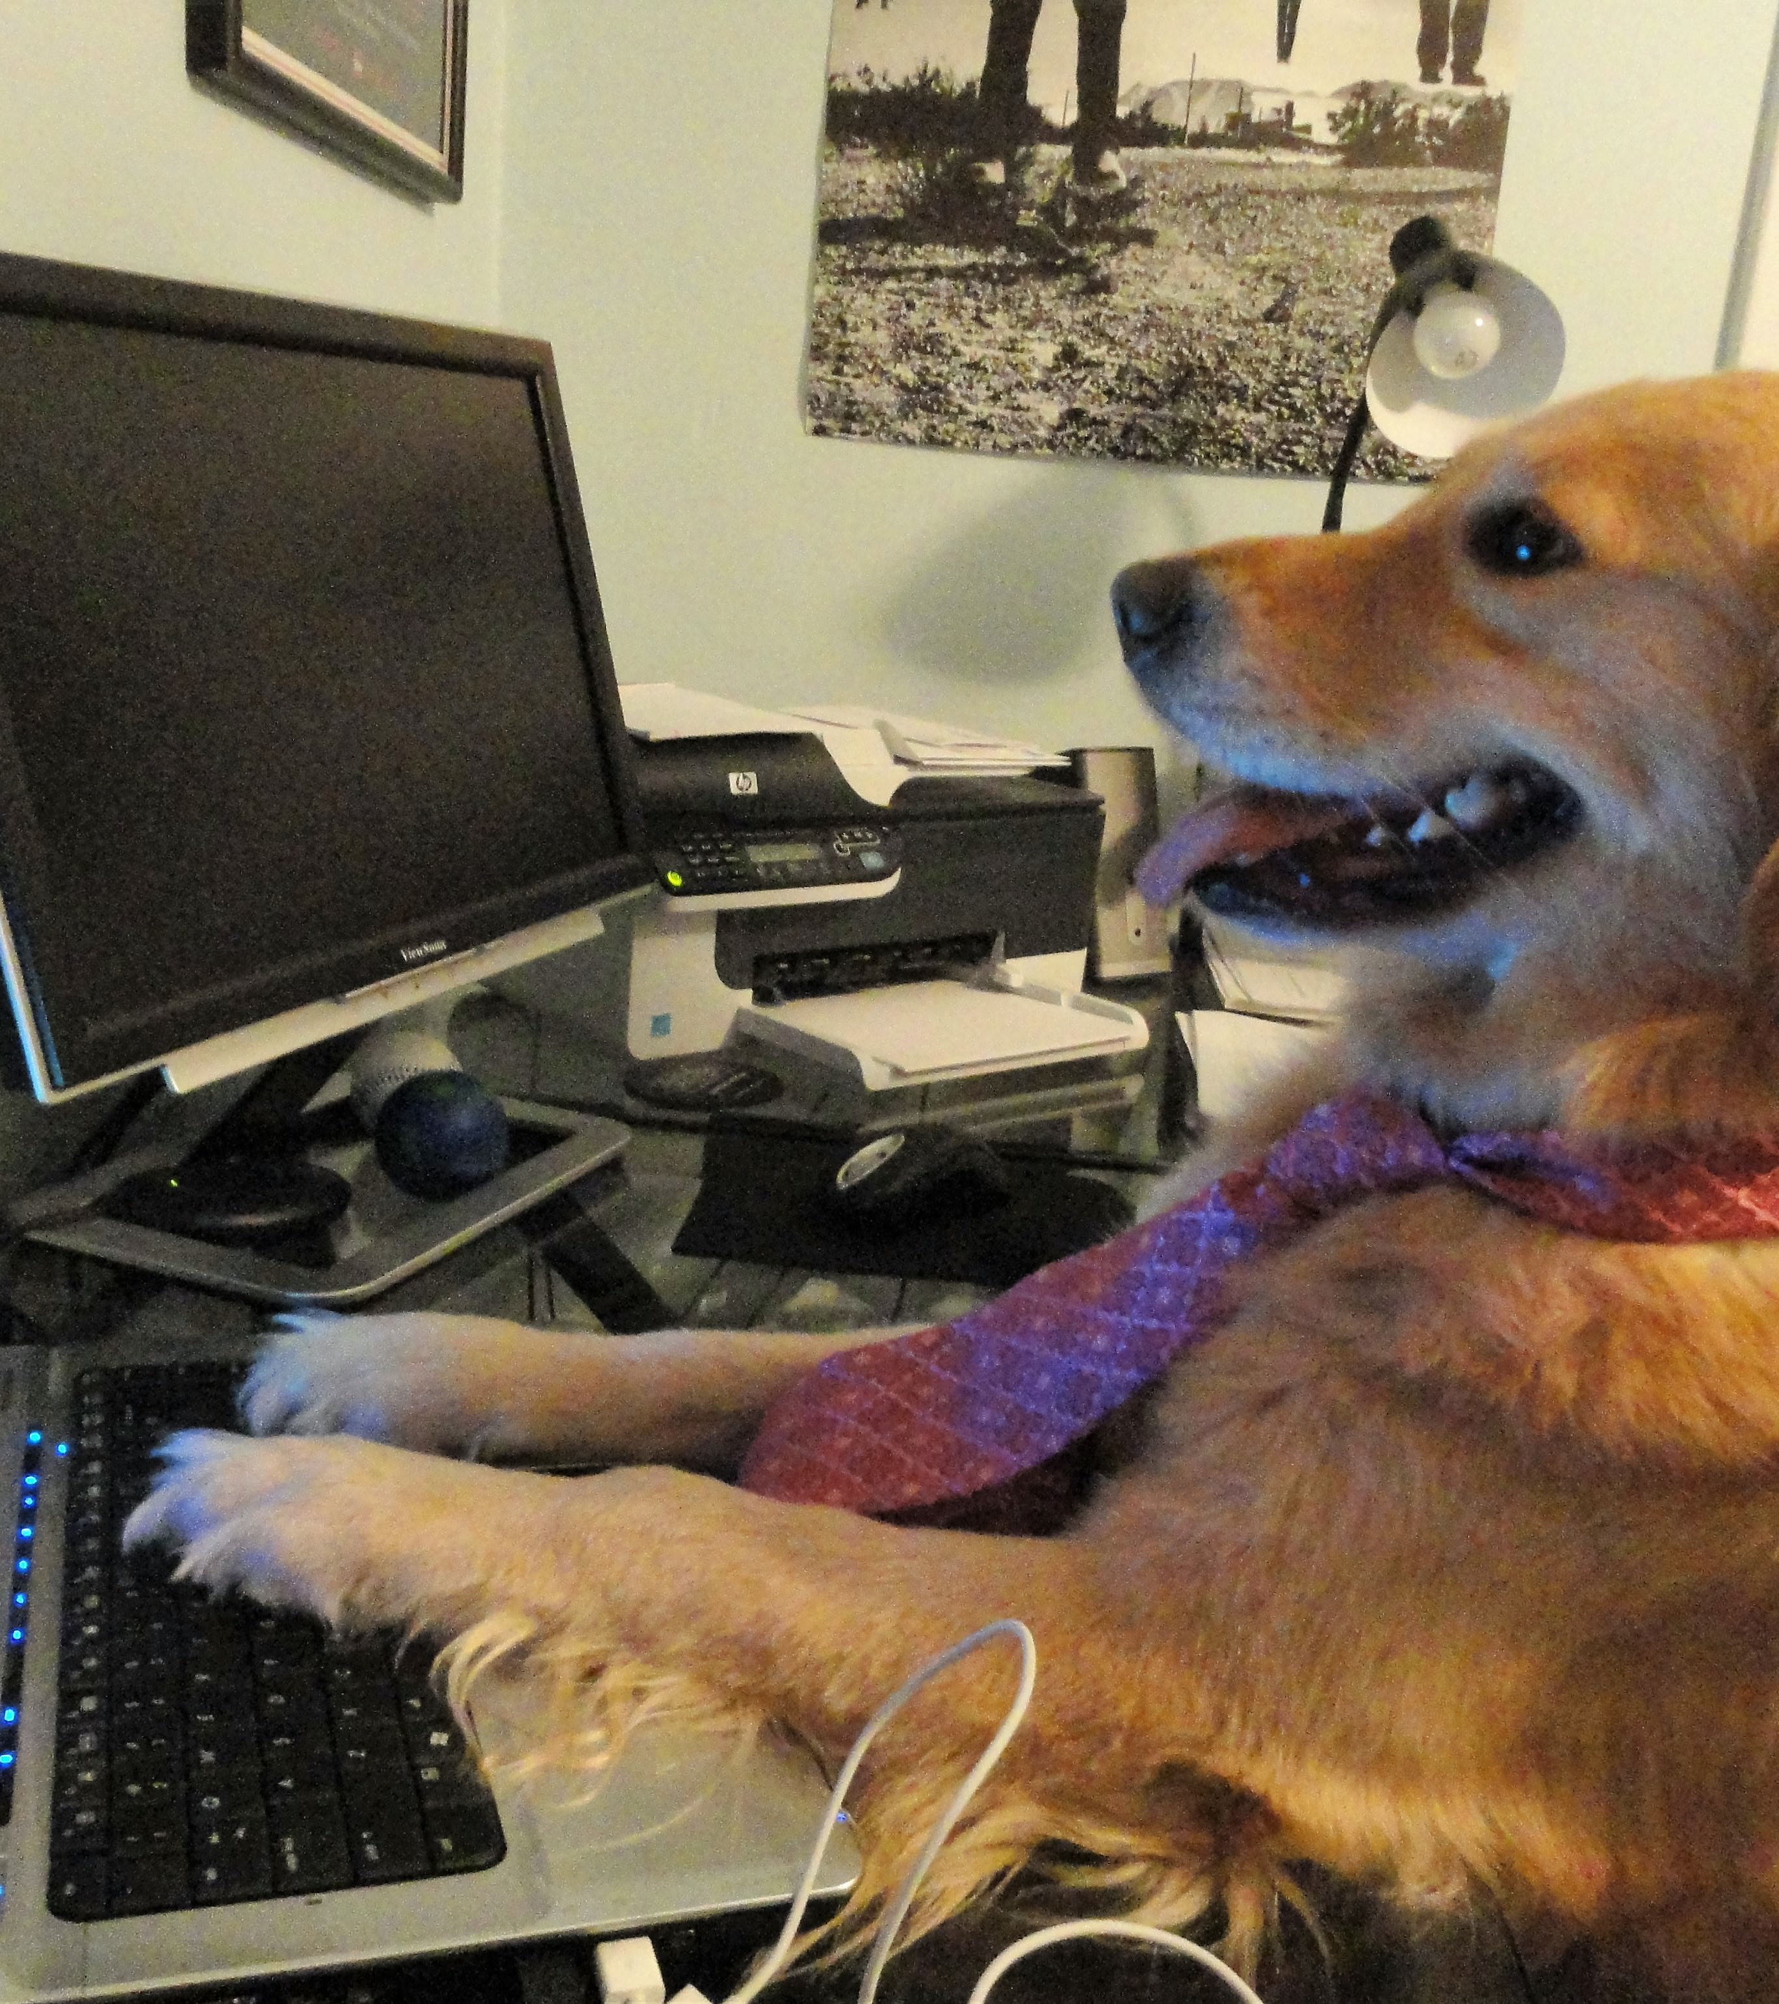
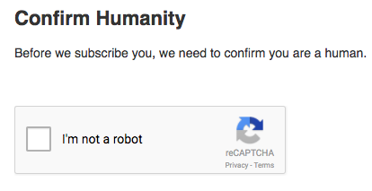
AMIFOST-2018
On the internet
Nobody knows
User is a DOG.
Notes:
Well the reality is that still we did not 100% know if the person you are communicating is a dog, a robot or a fake person. That is why nowadays you see lots of “I am human” verification on internet.
So we still don’t have trust on information we get through internet. And this is problem especially in food sector when we are grabbing data from lots of sources, parties and we don’t know if it is trustworthy.

Slide 4

AMIFOST-2018
“Now, in the hyper-connected and ever evolving world, transparency is the new power.”
Benjamin Herzberg -Program Lead, World Bank
Notes:
Blockchain technology will increase the transparency into our food system and provides capability to quickly and efficiently trace and recall products. This solution provides participants with a shared view of food ecosystem information, from farm to store. As said by Benjamin Herberg of worldbank, in this world transparency is the new power. And mostly people when they talk or think about blockchain they relate it to financial concept. Thanks to bitcoin. But I do believe that this technology can change the food industry as well. To explain my point I’ll be talking about two main factors in food industry.

Slide 5
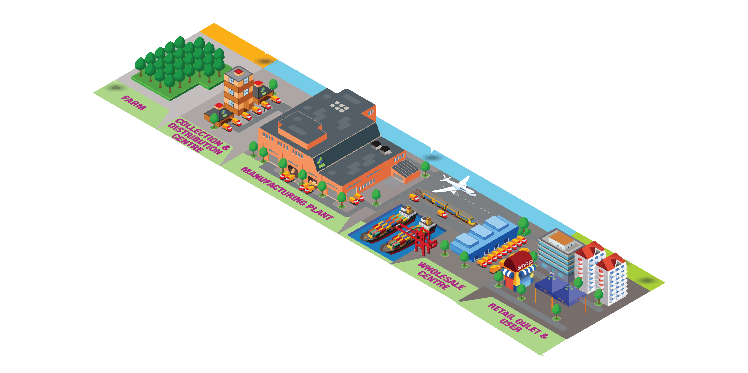
AMIFOST-2018
Exploring
FOOD TRACEABILITY
01
BENEFITS - CHALLENGES - OPPORTUNITIES
Image Source: www.mytraceability.com
Notes:
First we will explore the benefits, challenges and opportunities that traceability provides and how disruptive technologies like block chain can revolutionise the food industry.
Traceability is just not about data, identifiers, bar codes, RFID, tags, and any information that needs to be linked together to make traceability possible.
Traceability is about systematic ability to access any or all information relating to a food under consideration, throughout its entire life cycle, by means of recorded identifications.

Slide 6
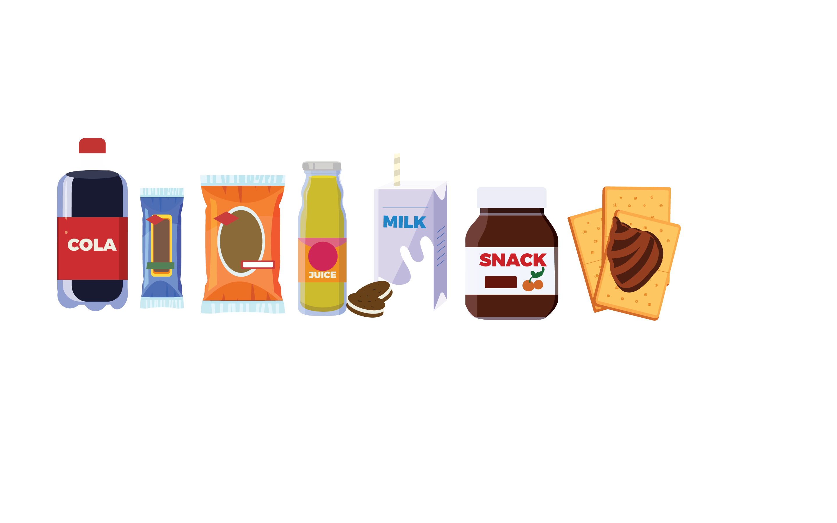
AMIFOST-2018
Exploring
FOOD SAFETY
02
BENEFITS - CHALLENGES - OPPORTUNITIES
Notes:
Secondly I’ll show you how blockchain can help with our ability to respond to critical food safety and security concerns.

Slide 7

AMIFOST-2018
What is
BLOCKCHAIN TECHNOLOGY?
Blockchain is an uncensored,
shared and unalterable recordings
of the history of transactions.
BENEFITS:
TRUSTS
ACCOUNTABILITY
TRANSPARENCY
Blockchain technology was created to serve a highly political intent, a free and uncensored network where all can participate with equal access.
Notes:
Blockchain is an uncensored, shared and unalterable recordings of the history of transactions. But the main feature of this technology is it is not centralised. It is not owned by anyone party. It is democratised. This is important because it increases trust between parties because no one is superior than other. It increases accountability and transparency in the system. But you might be wondering, What is the problem with our current system in food industry? I’ll Show you…

Slide 8


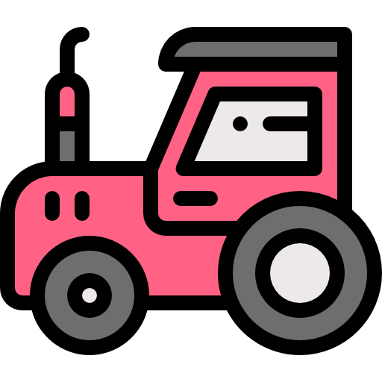

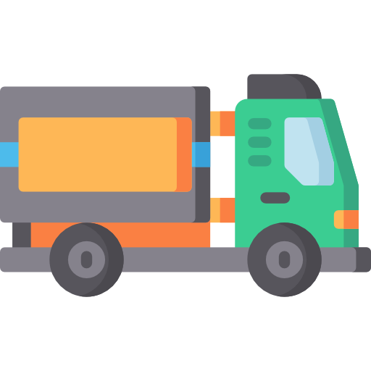

Today’s
SYSTEM IN FOOD INDUSTRY
AMIFOST-2018
INSUFFICIENT - EXPENSIVE - VULNERABLE
PARTY: A
PARTY: C
PARTY: E
PARTY: B
PARTY: D
PARTY: F
Notes:
If we look at the current system in food industry which includes multiparty cooperation. It includes records from farms, processing units, transportation, distributors, retailers, auditors etc. So each party right now uses their own internal system to maintain records. So sometimes their can be disagreements between the parties. It creates friction in the whole system which makes it insufficient and vulnerable. Sometimes these records are text messages, emails or worse paper documents which are easy to alter or change the record and all this create lots of expense for the company.

Slide 9

BLOCKCHAIN
SYSTEM IN FOOD INDUSTRY
AMIFOST-2018
PARTY: A
PARTY: C
PARTY: E
SHARED - DUPLICATED - PERMISSIONED
PARTY: B
PARTY: D
PARTY: F
Notes:
Now if we see the same system with blockchain technology, So it creates a single database for which everyone has a copy. By the help of this system, any party can track the records. For e.g. where the food shipment is or in what condition it is in? This technology creates a single database so their is no chance of any disagreement or friction between parties involved. Their is only one state of truth that is recorded and distributed to every member. No party has any priority. And all this records are permanent. So if their is any debate or argument which might happen in future, there is a permanent, unalterable record of that to solve these issues.

Slide 10

WORKING
OF BLOCKCHAIN TECHNOLOGY
AMIFOST-2018
Notes:
As the name indicates it is chain of blocks that contains information. Once any recording of data is done in blockchain, it is extremely impossible to change it. So how does that work, let’s take a closer look at the block.

Slide 11
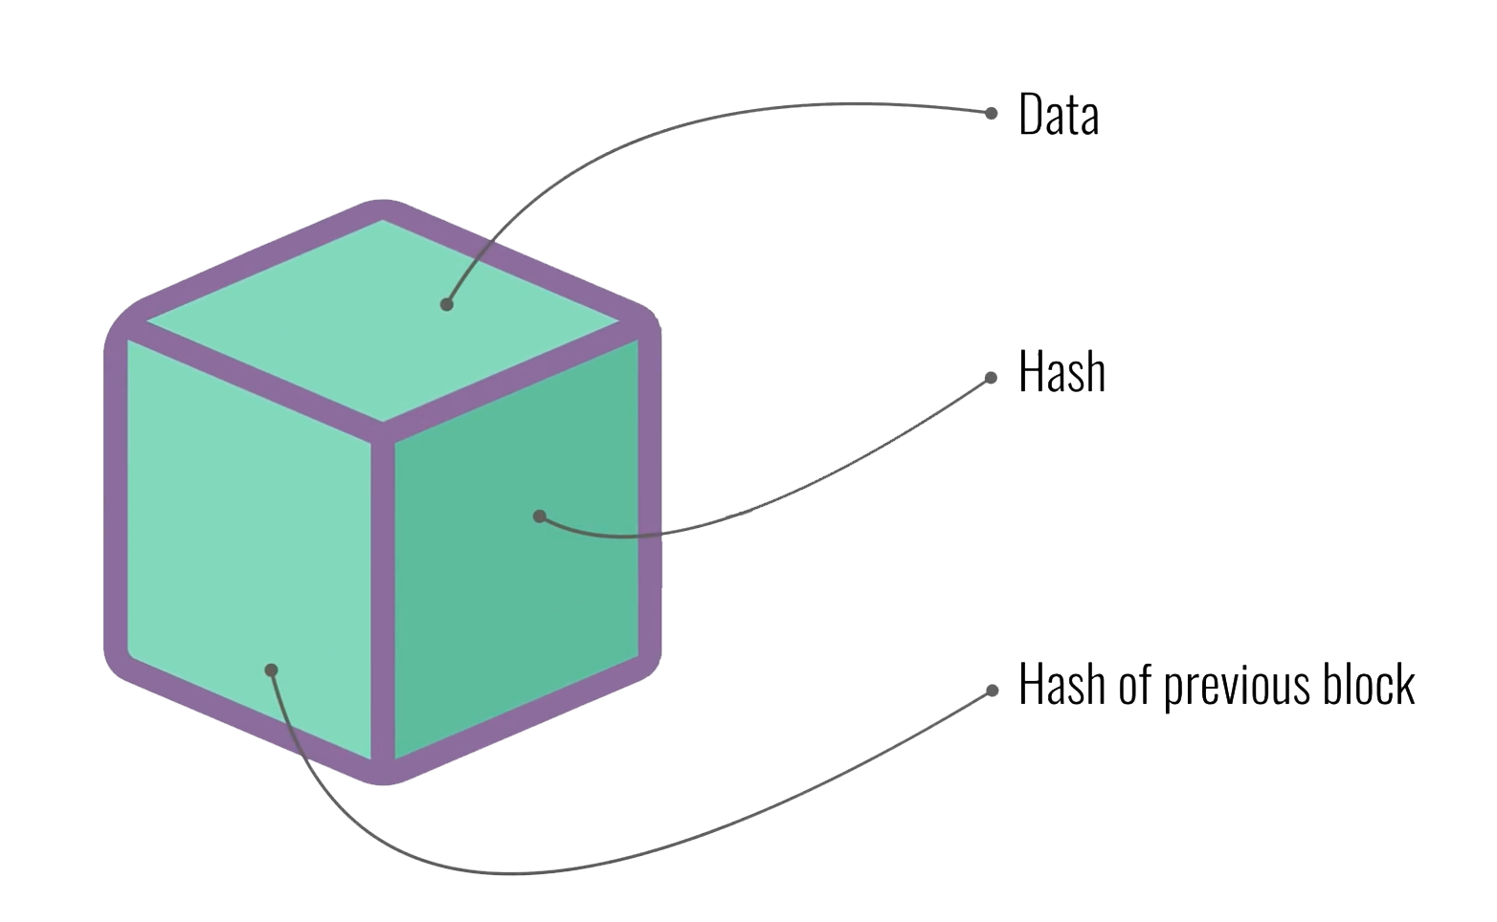
WORKING
OF BLOCKCHAIN TECHNOLOGY
AMIFOST-2018
ehedewfgfw23253wgf35r26352gdfq2e1325127352167gg
Notes:
First thing, data stored in block chain depends on the party or stage on which we are using it. Next thing, every block has a HASH, HASH is like a fingerprint of block. It is unique for every block. And it helps in identification of contents in the block. Now you might be wondering, what if we change data inside the block.

Slide 12
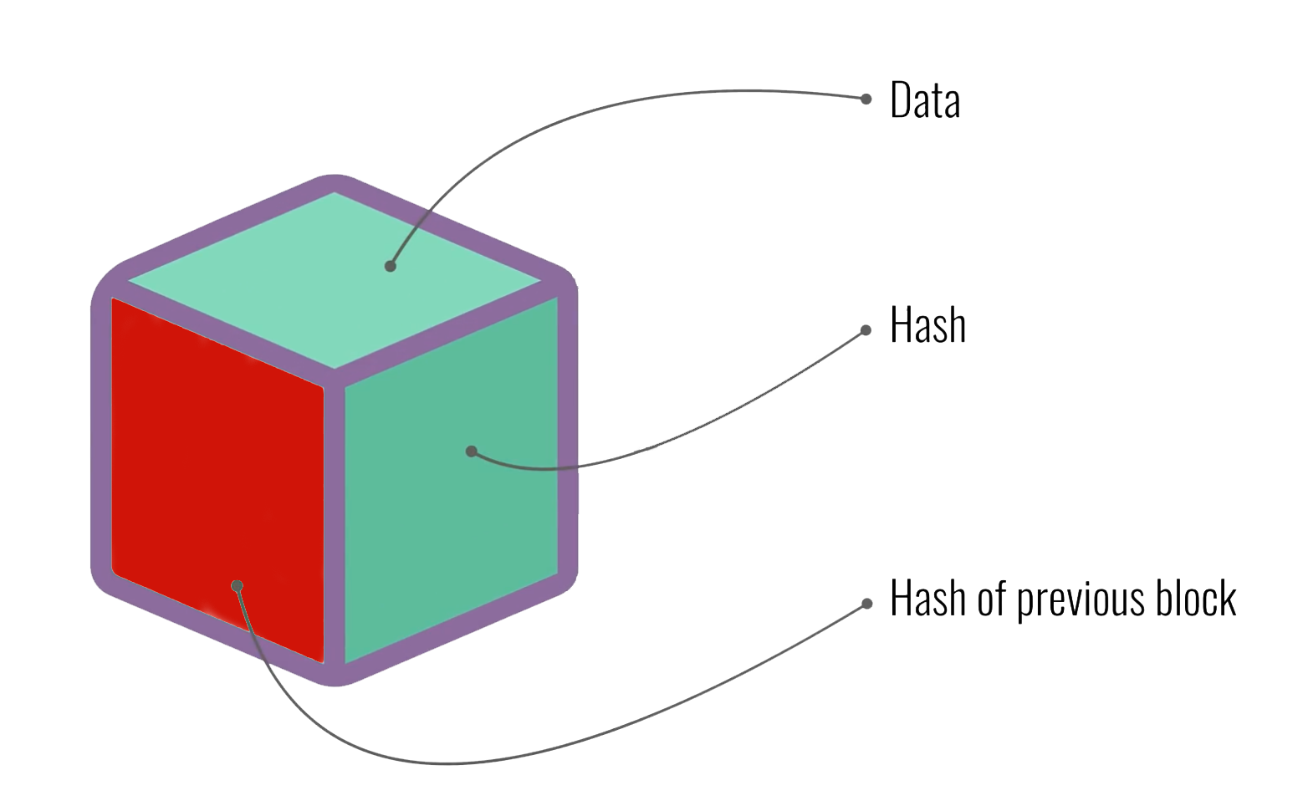
WORKING
OF BLOCKCHAIN TECHNOLOGY
AMIFOST-2018
tigjbyiryitmvmyuyio758645mg45u6y45m54i6y8
Notes:
So changing something inside the block will also cause hash to change. So hashes are very crucial when we want to detect any changes in the information in the block.

Slide 13
WORKING
OF BLOCKCHAIN TECHNOLOGY
AMIFOST-2018
ehedewfgfw23253wgf35r26352gdfq2e1325127352167gg
Notes:
And the third element is hash of the previous block. And it effectively create the chains of block which makes blockchain so secure. Let’s take an example..

Slide 14
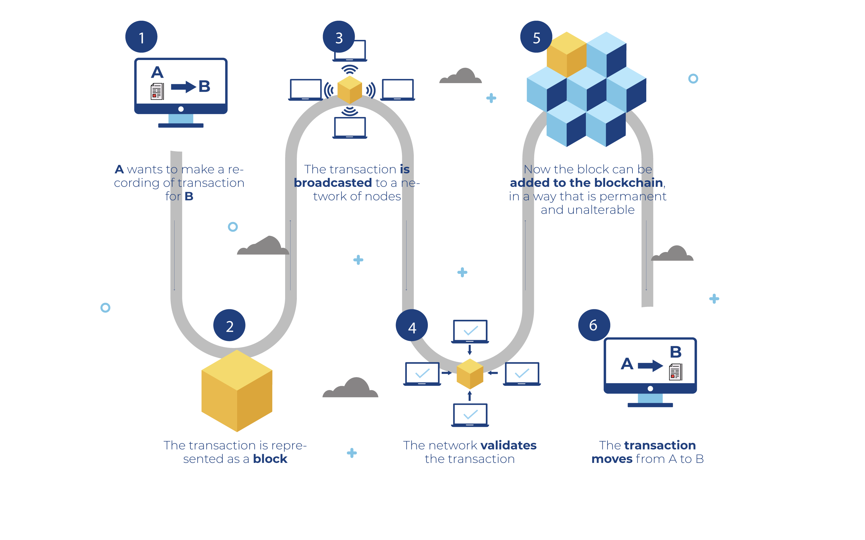
WORKING
OF BLOCKCHAIN TECHNOLOGY
AMIFOST-2018
Notes:
A wants to make a recording of transaction to B. Transaction not only includes financial transaction, here transaction can be anything like packaging date, shipping information, nutritional content etc.

Slide 15
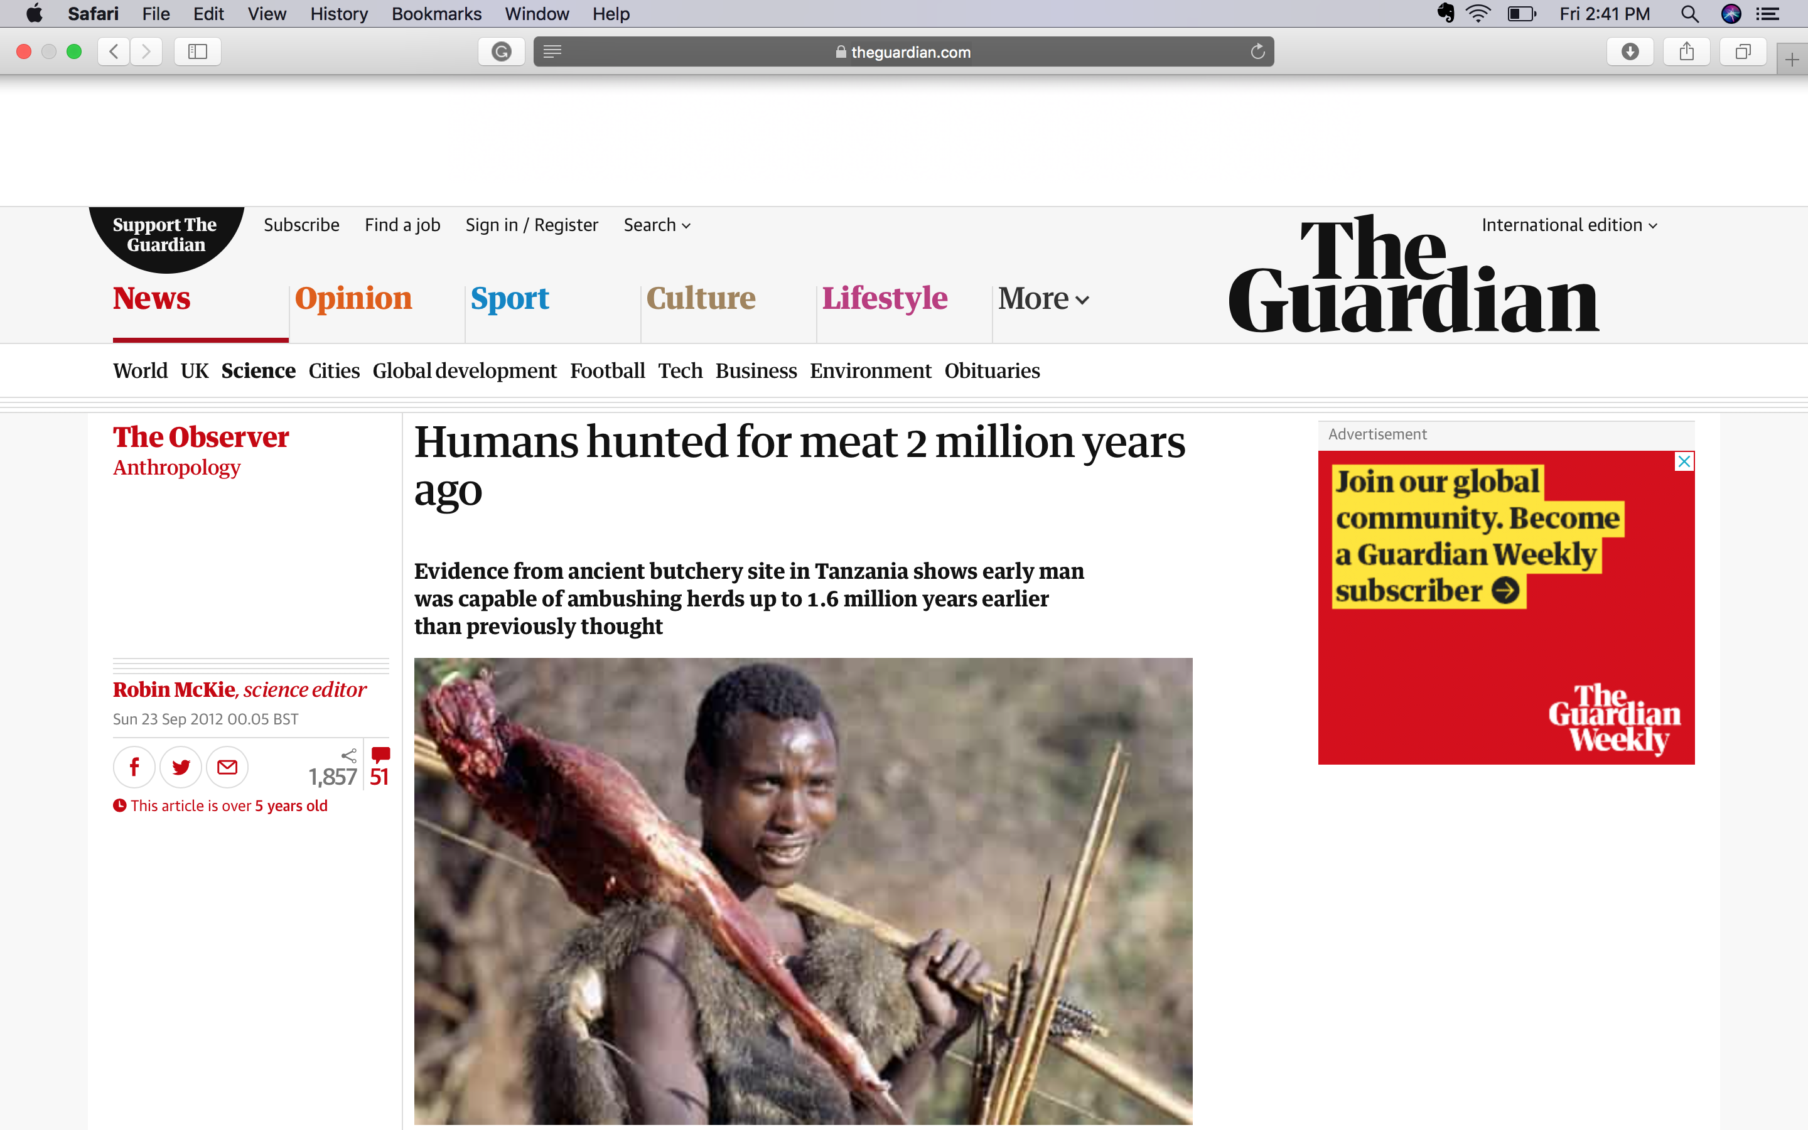
WHY DO WE NEED
BLOCKCHAIN TECHNOLOGY
AMIFOST-2018
Source: https://www.theguardian.com/science/2012/sep/23/human-hunting-evolution-2million-years
Notes:
To explain this in simple terms, I want to show you how globalisation of food evolved with the time. At the beginning of time, we humans were mainly hunters. You can see the evidence which found in Tanzania shows that early man hunted meat around 2 million years ago. They didn’t needed any traceability because they just go hunt their food and come back and eat. They were not concerned about food safety either.

Slide 16
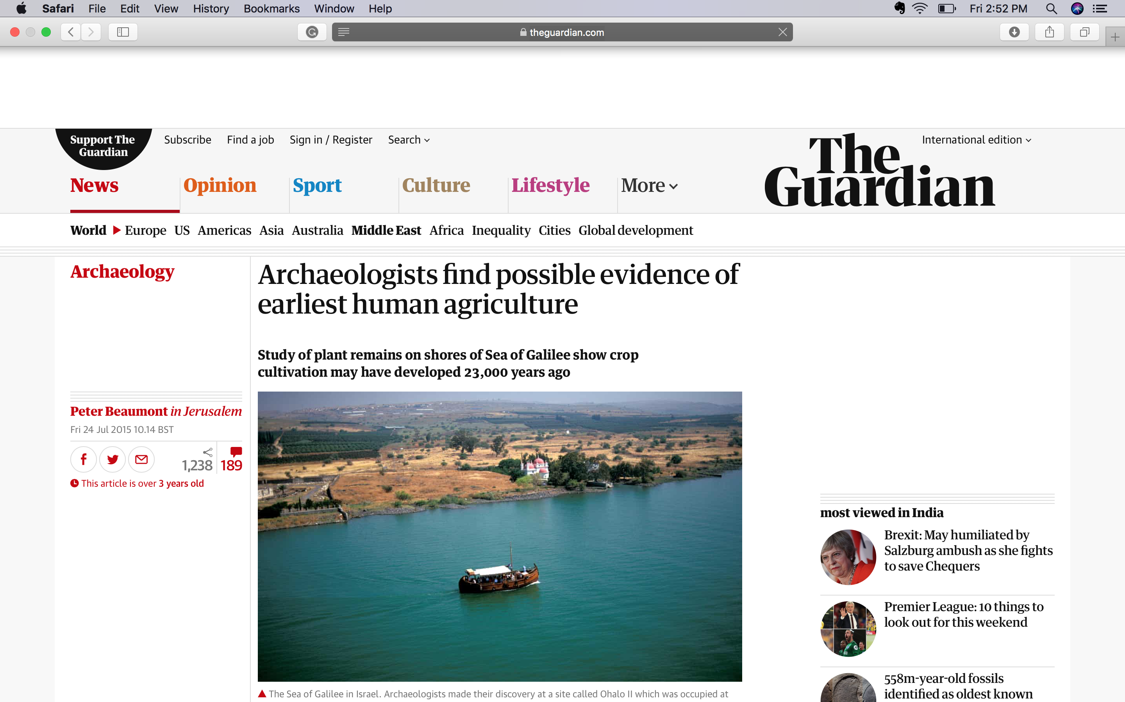
WHY DO WE NEED
BLOCKCHAIN TECHNOLOGY
AMIFOST-2018
Source: https://www.theguardian.com/science/2012/sep/23/human-hunting-evolution-2million-years
Notes:
Now if go forward in time, they started domesticating animals and started agricultural practices for food production. A discovery in 2015 shows that farming began around 23000 years ago.

Slide 17
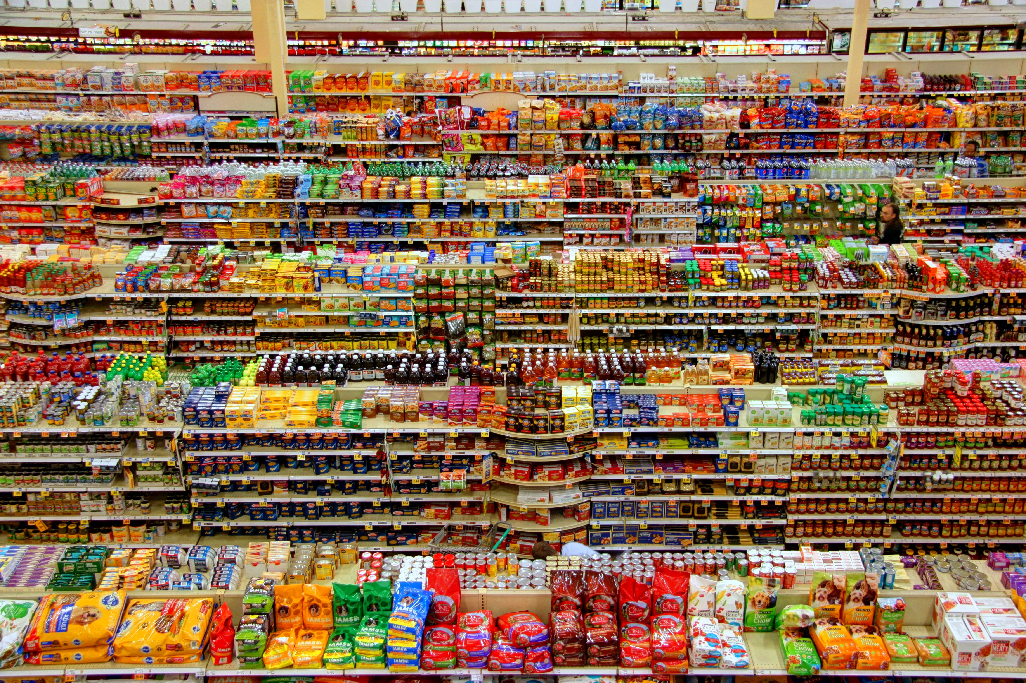
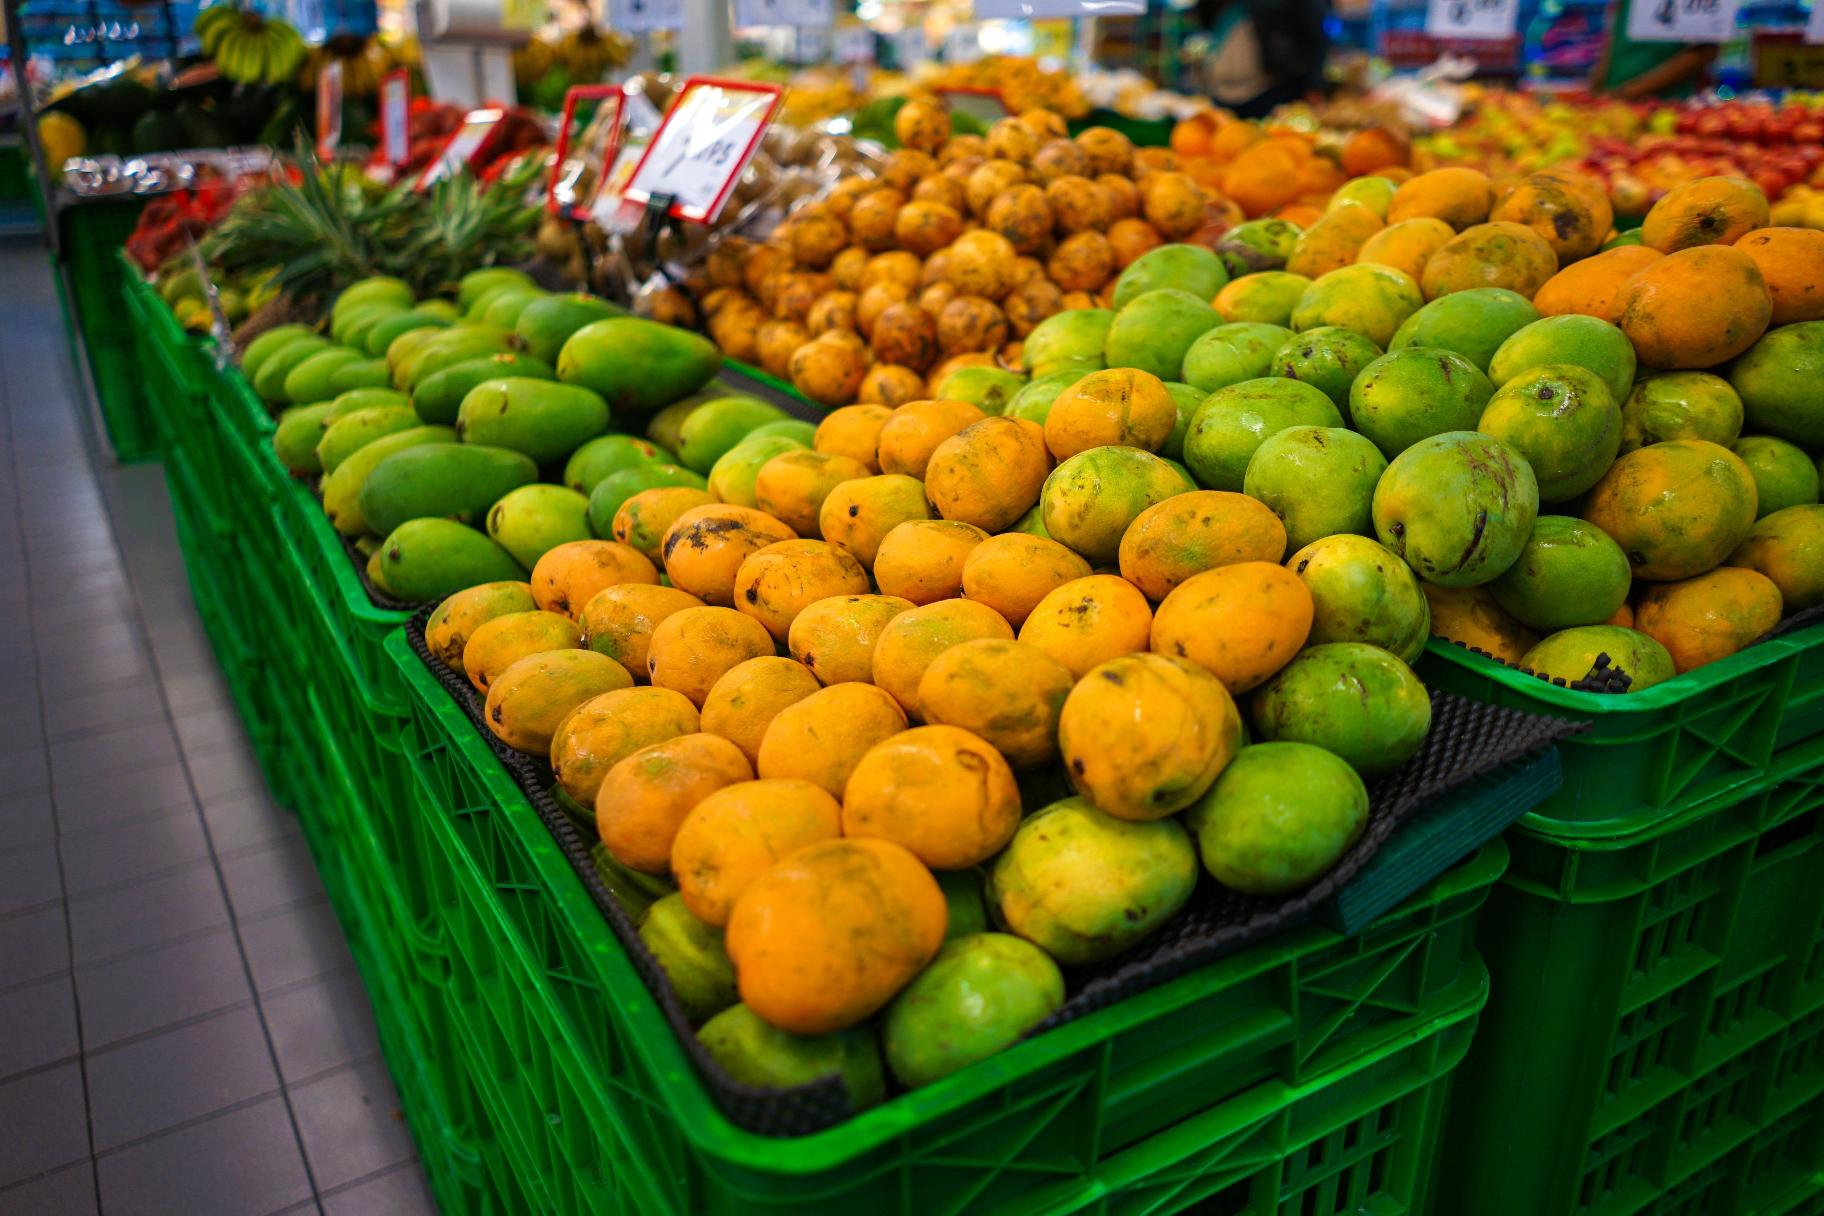
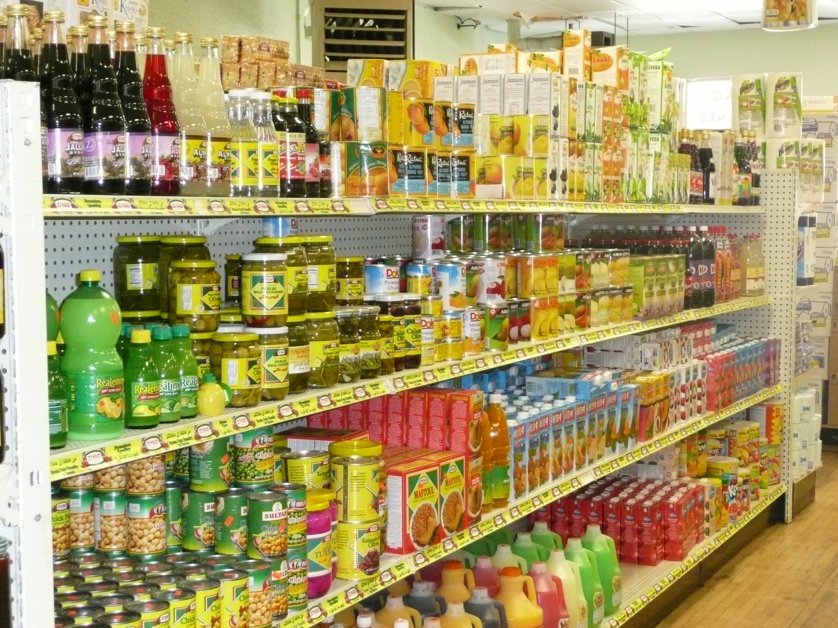
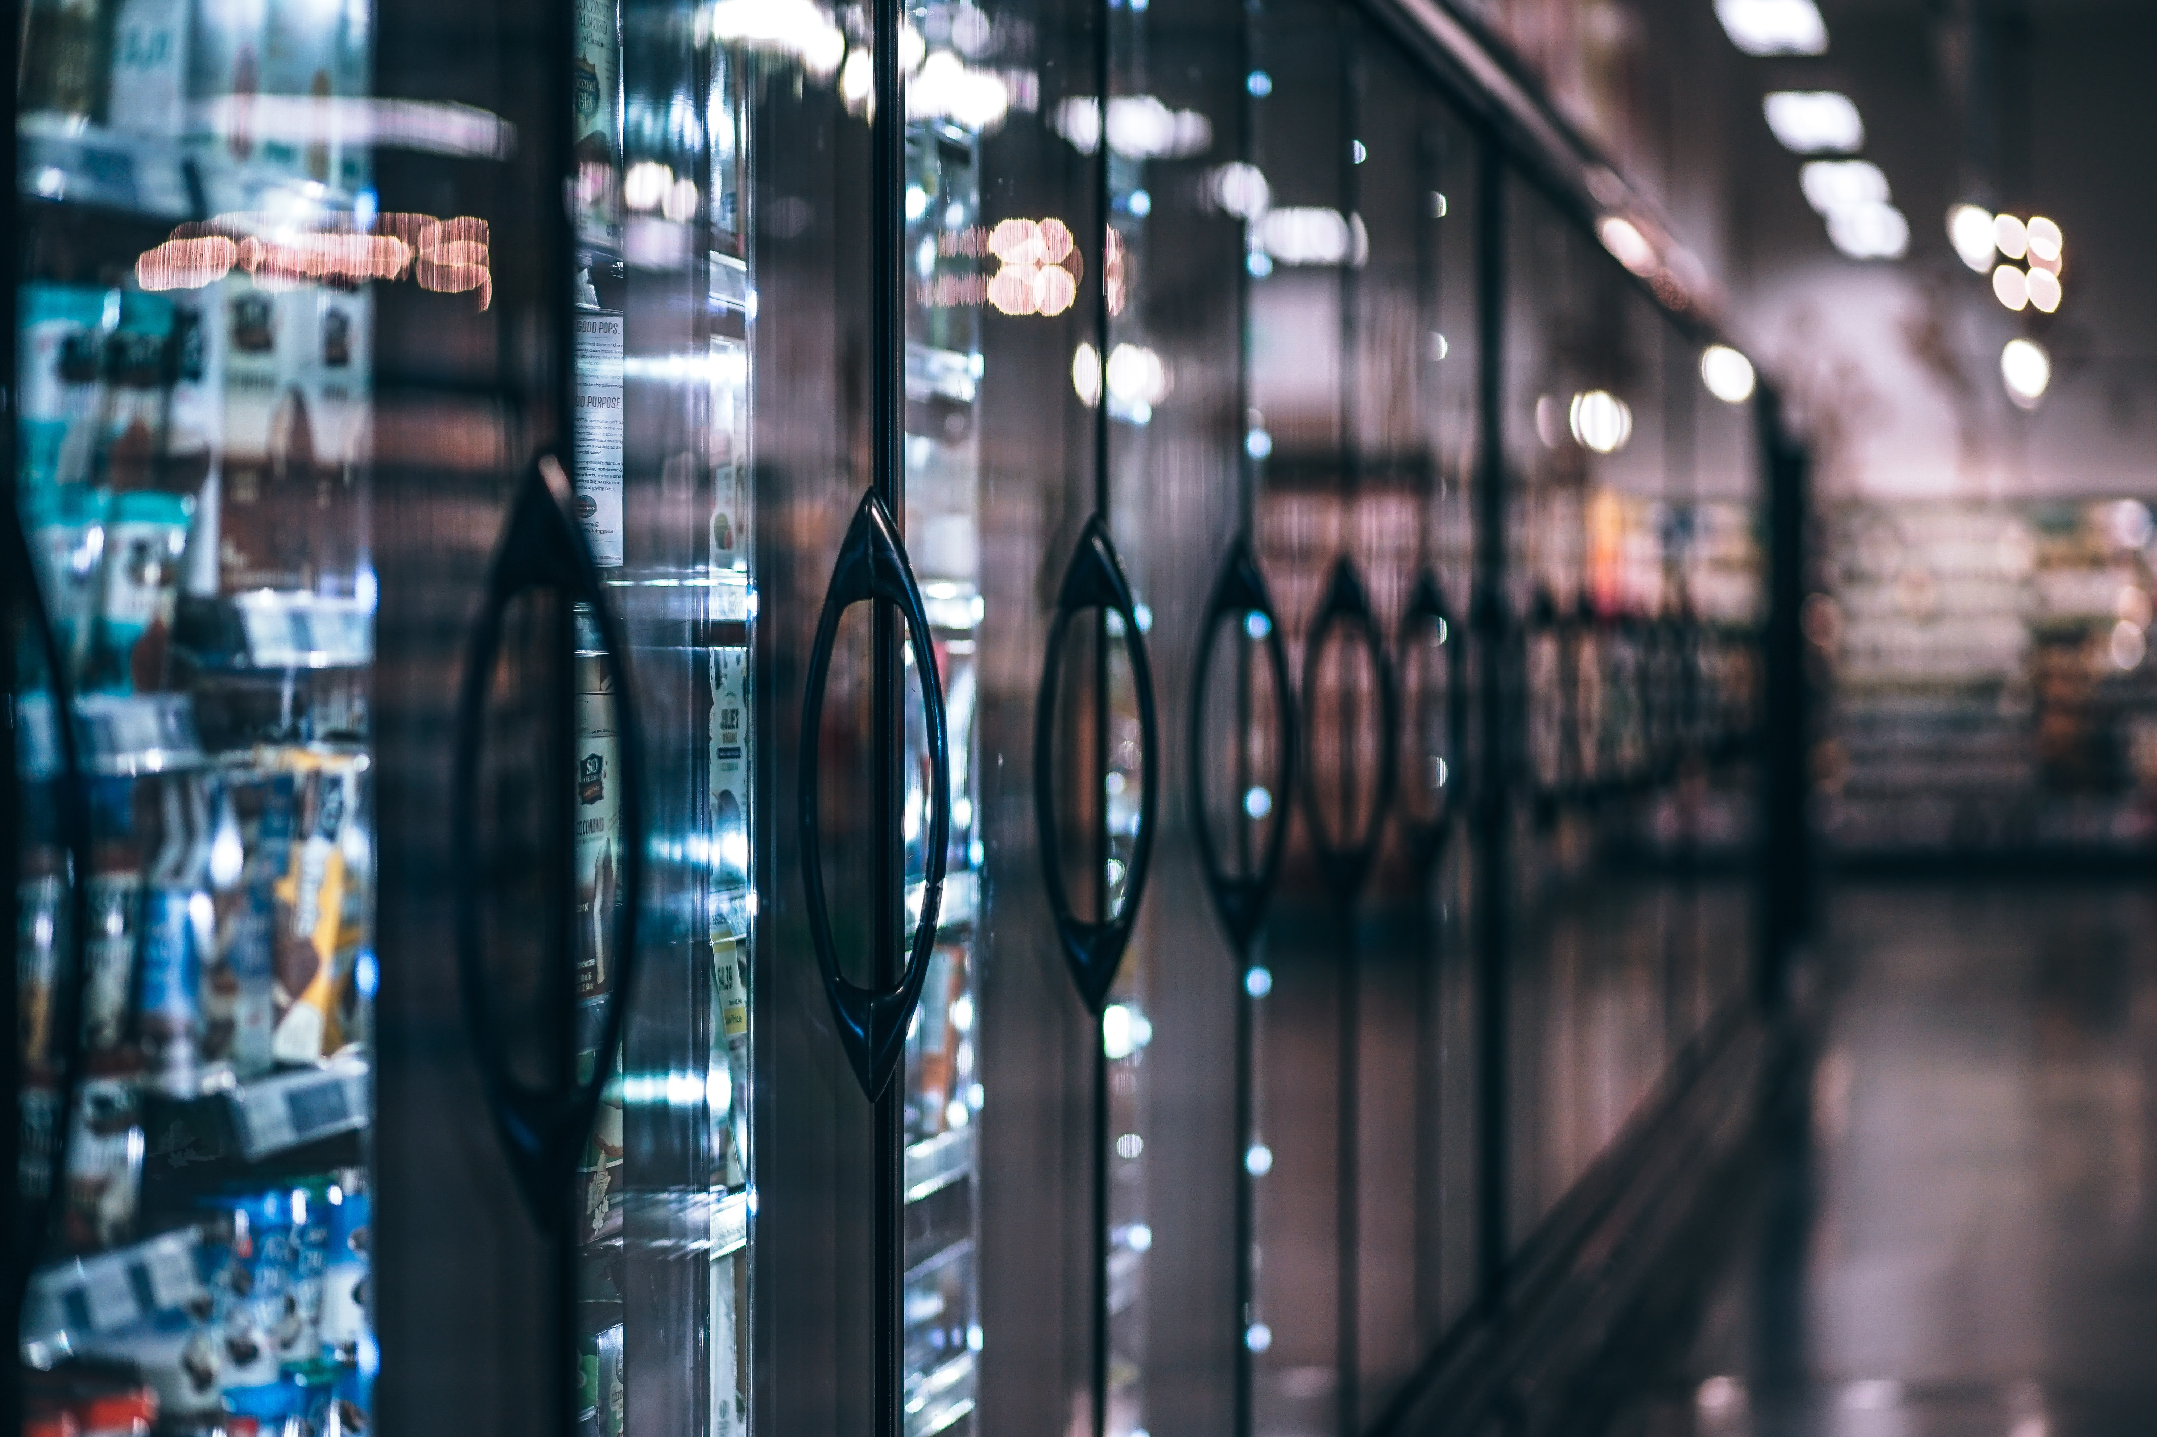
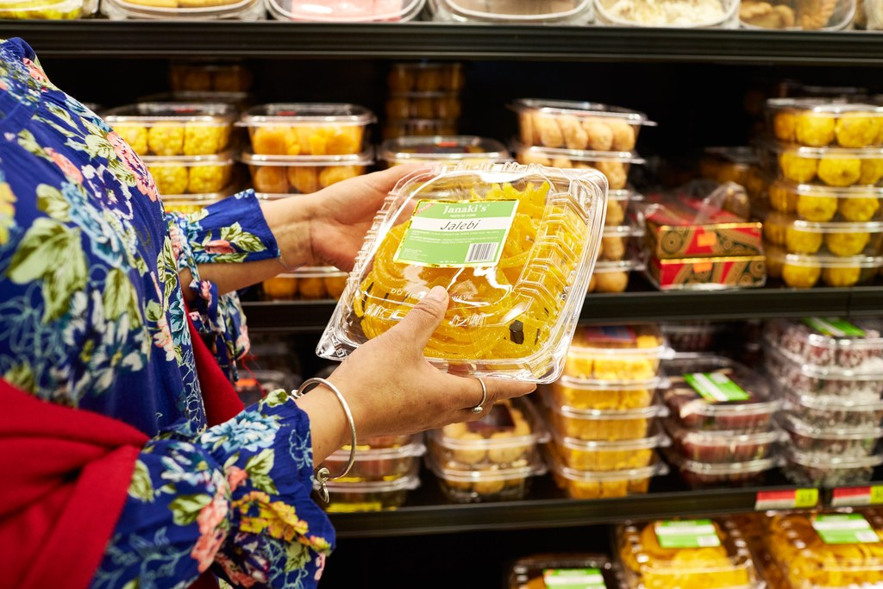
WHY DO WE NEED
BLOCKCHAIN TECHNOLOGY
AMIFOST-2018
TODAY
Notes:
Without wasting any more time on history lesson, if we come to today’s scenario, these are supermarket all around the world. Thousands of food products, ready to eat and frozen from all around the world. My father said to me that when he was child around my age, he use to eat apples only once in a month because they were expensive and are not native to Rajasthan. Now I eat apple almost every single day because now world is global food village.

Slide 18








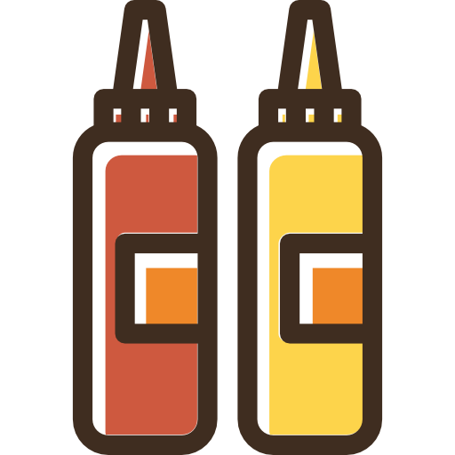

GLOBAL
COMPLICATED FOOD SYSTEM
AMIFOST-2018
Wheat flour
Malted barley flour
Thiamine
Niacin
Water
Soy flour
Baking soda
Sesame seeds
Yeast
Oil
Salt
Enzymes
Riboflavin
Calcium sulphate
And many more…
Milk
Milk fat
Water
Cream
Salt
Sodium phosphate
Sorbic acid
Artificial color
Cheese culture
Acetic acid
Starch
Enzymes
And many more…
Cucumbers
Water
Vinegar
Salt
Calcium Chloride
Natural flavourings
Turmeric
And many more…
Grill Seasoning
Salt
Pepper
Cottonseed oil
Soybean oil
And many more…
Source: National Centre For Food Protection and Defence
Soybean Oil
Pickels
Distilled Vinegar
Water
Egg Yolks
Corn
Syrup
Sugar
Onion
Spices
Mustard
Gum
Salt
Turmeric
EDTA
Garlic
Color
Paprika
Hydrolysed Proteins
And many more…
Lettuce
Tomato
Onion
Chicken
AND MANY MORE DEPENDING ON THE BURGER…
Notes:
Some people say they are on pro-local diet. But It is hard to live on pro-local diet. If we see an example of burger. It looks super simple right? Let’s see what it contains. You can see it contains lots of things and that makes global food system very complex. I’ll increase its complexity further more. Let’s see where all these things in burger come from.

Slide 19
GLOBAL
COMPLICATED FOOD SYSTEM
AMIFOST-2018
WHEAT GLUTEN
Australia
Belgium
Canada
China
Czech Republic
France
Germany
India
Lithuania
Netherlands
Poland
Russia
Switzerland
Thailand
U.K
Vinegar
Argentina
Australia
Austria
Belgium
Brazil
Canada
China
Chile
Colombia
Denmark
Dom. Republic
France
Germany
Greece
Hong Kong
Israel
Italy
Japan
S. Korea
Lebanon
Peru
Poland
Portugal
Serbia
Philippines
Russia
S. Africa
Singapore
Spain
Sweden
Turkey
Taiwan
U.K.
Tomatoes
Belgium
Canada
Colombia
Costa Rica
Dom. Republic
Guatemala
India
Israel
Morocco
Mexico
Netherlands
New Zealand
Poland
Spain
Source: National Centre For Food Protection and Defence
Garlic Powder
Brazil
Canada
China
Germany
India
Israel
Japan
S.Korea
Mexico
AND MANY MORE DEPENDING ON THE BURGER…
Notes:
Now you can see the overall picture of a single burger. And this is true in every food product you consumer coffee, cake, anything. And due to this complicated food system their is concern about safety and quality of food. Let’s see the more clear picture. Now what are the concerns with this complex food system

Slide 20


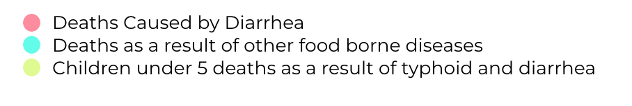
GLOBAL
COMPLICATED FOOD SYSTEM
AMIFOST-2018
EVERY YEAR 600 MILLION
Notes:
World health organization figures from food safety fact sheet of last year shows that, worldwide, food borne illnesses cause more than 4 LAKH deaths, and billions of dollars in healthcare worldwide.

Slide 21
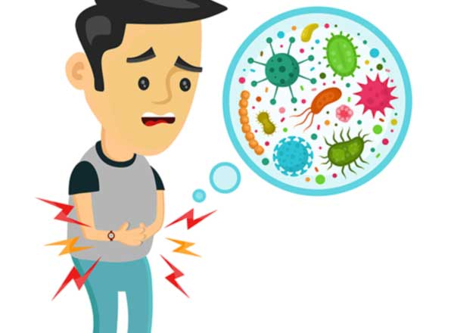
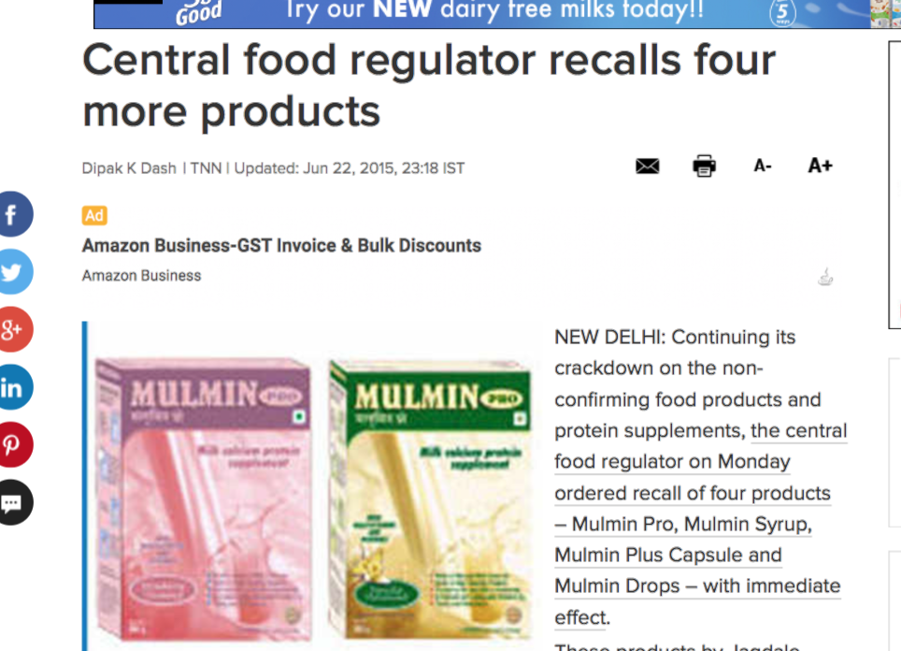
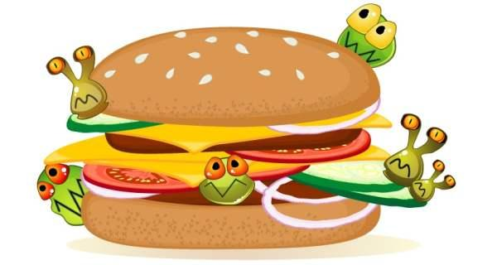
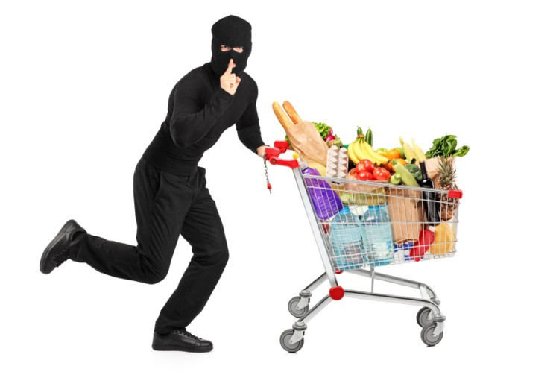
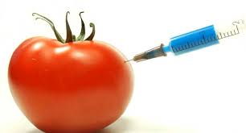
GLOBAL
COMPLICATED FOOD SYSTEM
AMIFOST-2018
Image Source:https://ercare24.com
https://timesofindia.indiatimes.com
www.foodnavigator.com
www.thehealthsite.com
www.thefoodsafetycompany.com
Notes:
Concerns are due to: more food borne diseases are growing: E.coli, Listeria etc.
Higher number of food recalls.
Rise in fraudulent activities in food chain and fake products.
Higher contamination and spoilage risks
Increased threat of food terrorism.
Impact of these things:
Economic loss from negative impact of recalls, growing distrust in food system because customer confidence is too fragile. And increased business cost to comply with all regulations
THIS IS WHY TRACEABILITY IS IMPORTANT

Slide 22


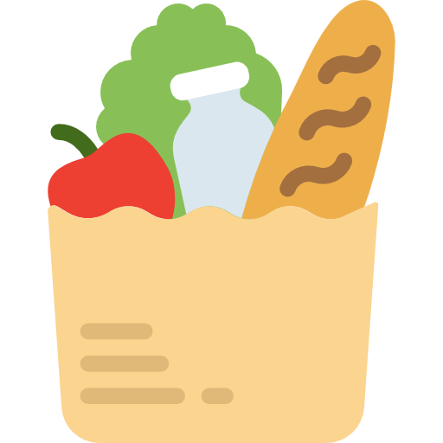

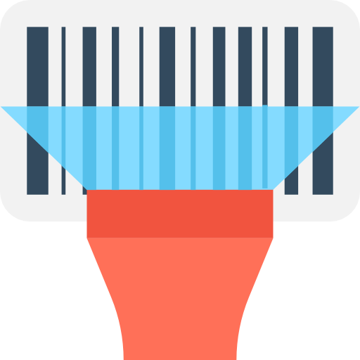
AMIFOST-2018
LIKED THE
PRESENTATION?
WANTS TO DISCUSS FURTHER?
Yogesh Tak
Amity Institute of Food Technology
yogesh.tak@student.amity.edu
THANK
YOU
KEY POINTS
Image Sources:
www.unsplash.com
www.flaticon.com
www.who.int
Data Sources:
“Food Safety” (Fact Sheet) - WHO, October, 2017
“High Cost of Food borne illness” - The Ohio State University, June, 2015
“IBM Food Trust” - IBM Corporation
From Farm to Blockchain - NYTimes, September, 2018
Food Safety
Food Freshness
Reduced Waste
Sustainability
Let’s build a smarter, safer, more sustainable global food system
Notes:
So you’ve heard all these great ideas and future of food, for this some nerd in the background need to do all the hard work and heavy lifting of connecting the global food traceability chain to make all this cool stuff happen. I hope I would be that nerd in the future. THANK YOU.
Food safety- Securely trace products in seconds – not weeks – to mitigate cross-contamination, spread of food-borne illness, unnecessary waste and the economic burden of recalls.
Food freshness: Gain unprecedented visibility into supply chain data to improve freshness, increase shelf life and reduce product loss.
Reduced Waste: Maximize shelf life, optimize the supply chain and provide quick response to food recalls, all helping to reduce waste.
Sustainability: Identify inefficiencies, ensure quality of goods, track authenticity of products and certify provenance across the entire supply chain.

